Slide 1
MiniBridge - .. Why should we teach MiniBridge to established bridge players?
Linnea Edlund
Swedish Bridge Federation

Slide 2
Agenda
What is MiniBridge? A short overview
Why do we need it?
The MiniBridge-Cup concept
Resources

Slide 3
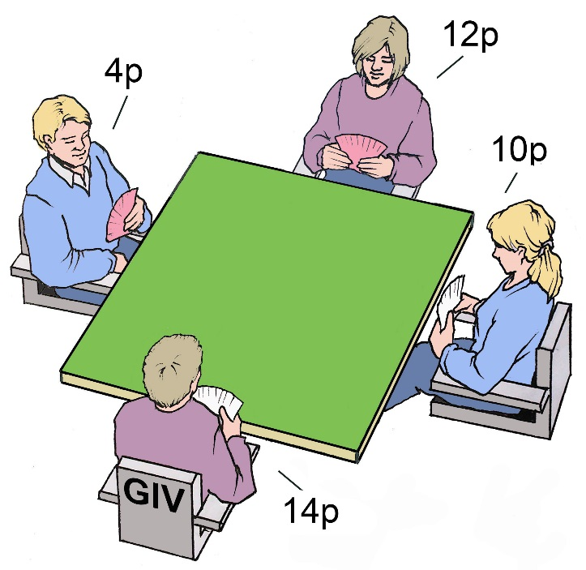
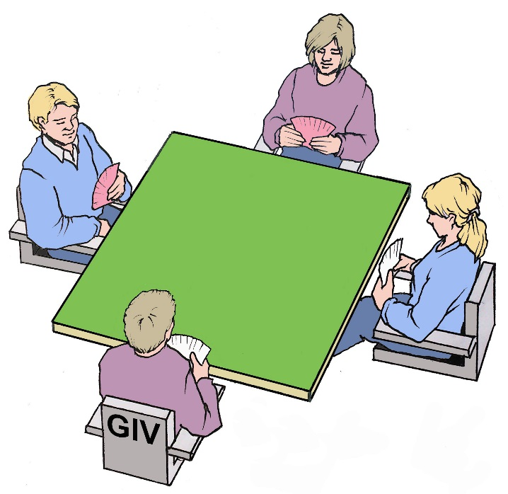
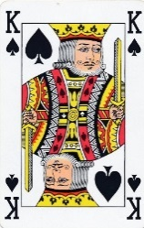
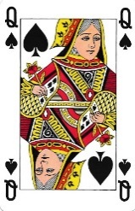
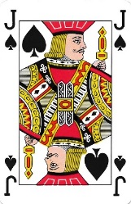
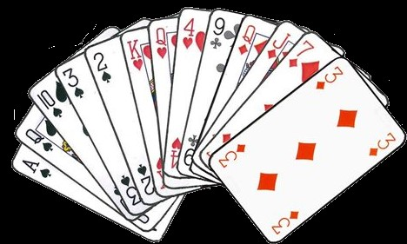
MiniBridge auction
Ace - 4 HCP
King: 3 HCP
Queen: 2 HCP
Jack: 1 HCP
Example hand
Every player announces their total HCP.
Spades 6 p
Hearts 5 p
Diamonds 3 p
Clubs 0 p
Total 14 p
The pair with most of the HCP wins the auction, and get to choose the contract.
The player with most HCP will be declarer.

Slide 4
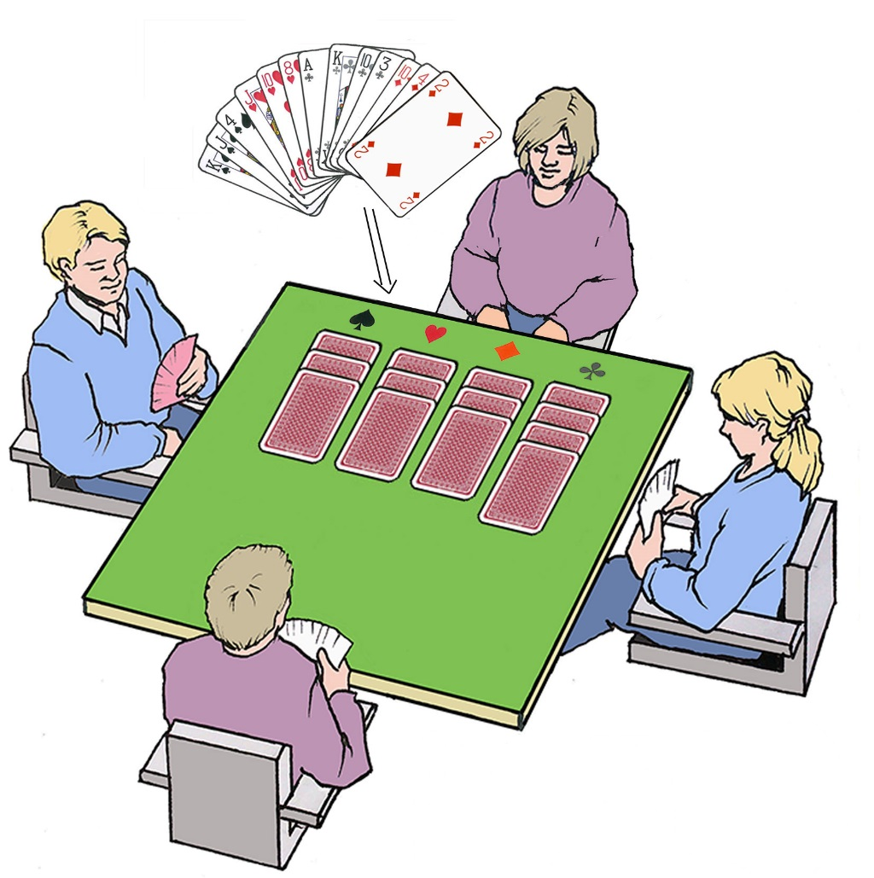
MiniBridge – Choosing the contract
The Dummy puts her cards in suit order to show the distribution.
Dummy
The Declarer decides if the contract is to be played as No Trump, or with a trump suit.
With at least eight cards in a common suit, it is recommended to use it as the trump suit.
Declarer
I will play with spades as trump.

Slide 5
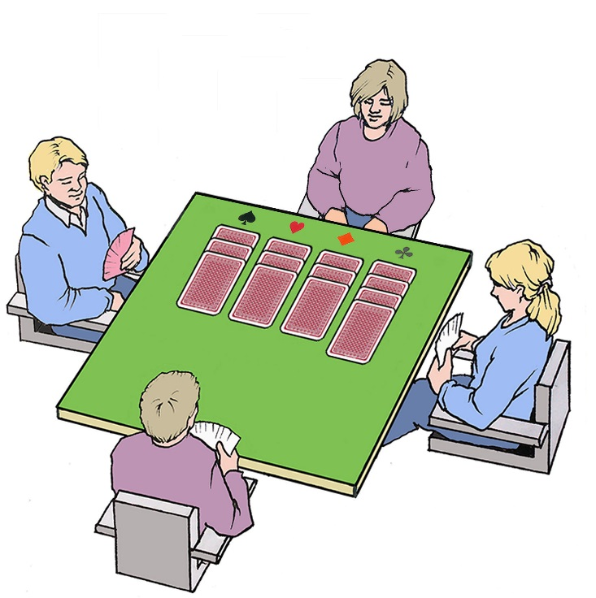
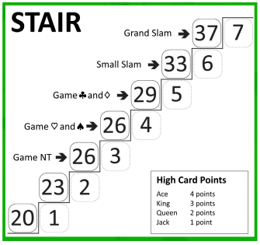
Find a suitable level!
For each deal declarer uses the ”Stair” to find a suitable level – Are there enough combined points to reach any of the bonus levels?

Slide 6
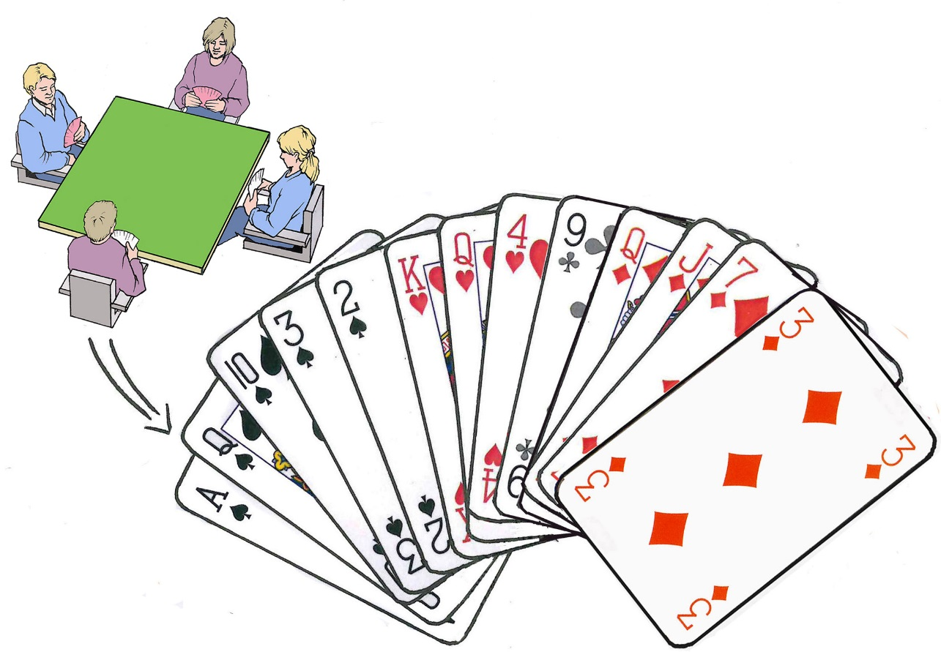
Choice of game
12p
4p
10p
14p
South
With 26 points and 8 spades the choice is to play 4♠ - reaching a bonus level!
South ends up as declarer.

Slide 7
Why should established bridge players learn MiniBridge?
With MiniBridge as a tool – all bridge players can let their friends experience bridge without many hours of training
If you can’t bring the people to the bridge club, bring bridge to the people!
Play in school, at work, at the golf club, at family Sunday dinner, at the pub!
All bridge players need to take responsibility for the survival of our game –
Everyone should know a bridge player! Be proud!

Slide 8
The MiniBridge Cup
Organized from a national level
Team tournament – mini round robin (groups of 4) – knock out finals
Sets a limited, and concrete ”start and end” for each participant
Possibility to win money! ☺
33 teams played in 2023
Matches played live or online
Open lobby with practise tables on RealBridge – accessible from the federation website. Just drop in and play whenever you like!

Slide 9
The MiniBridge Cup in Sweden
Ambassador
Mentor
Adepts
Regional/District level
Information to clubs and players
Helping mentors with teaching/material
Finding venues for matches
Finding mentors for adepts!
The captain of the team!
Coordinate matches with other mentors
The team members – beginners, or completely new player

Slide 10
MiniBridge Cup – Lessons learned
More ambassadors needed! Successful local clusters
2 mentors per team
Follow up the adepts after the tournament

Slide 11
Resources for training
http://www.worldbridge.org/resources/youth/wbf-teaching-material/ (WBF)
App: Synrey – 12 free deals per day!
RealBridge – MiniBridge settings for all kind of events
YouTube – just search for minibridge! ☺

Slide 12
Thank you!
Linnea Edlund
Linnea.edlund@gmail.com

